Slide 1
Multivariable Methods
CHAPTER 9

Slide 2
Learning Objectives (1 of 2)
Define and provide examples of dependent and independent variables in a study of a public health problem
Explain the principle of statistical adjustment to a lay audience
Organize data for regression analysis

Slide 3
Learning Objectives (2 of 2)
Define and provide an example of confounding
Define and provide an example of effect modification
Interpret coefficients in multiple linear and multiple logistic regression analysis

Slide 4
Definitions
Confounding—the distortion of the effect of a risk factor on an outcome
Effect modification—a different relationship between the risk factor and an outcome depending on the level of another variable

Slide 5
Confounding
A confounder is related to the risk factor and also to the outcome.
Assessing confounding
Formal tests of hypothesis
Clinically meaningful associations

Slide 6
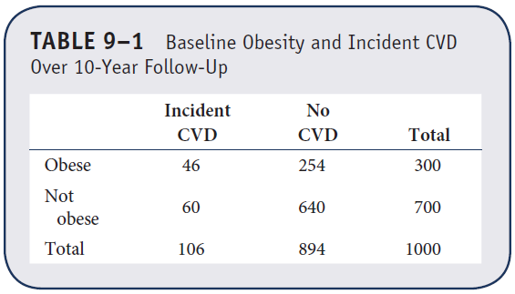
Example 9.1. Confounding (1 of 2)
We wish to assess the association between obesity and incident cardiovascular disease.

Slide 7
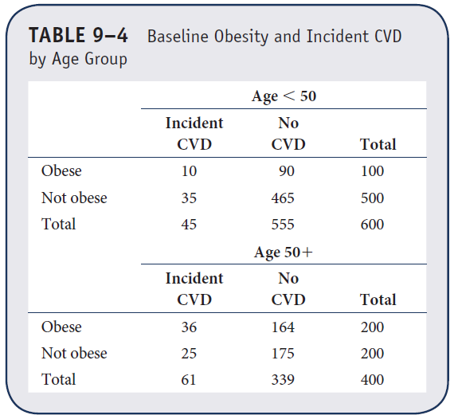
Example 9.1. Confounding (2 of 2)
Is age a confounder?

Slide 8
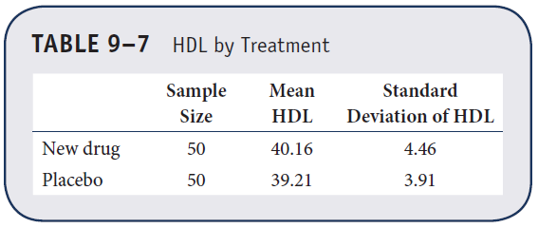
Example 9.2. Effect Modification (1 of 2)
A clinical trial is run to assess the efficacy of a new drug to increase HDL cholesterol.
H₀: m₁ = m₂ versus H₁:m₁ ≠ m₂
Z = –1.13 is not statistically significant.

Slide 9
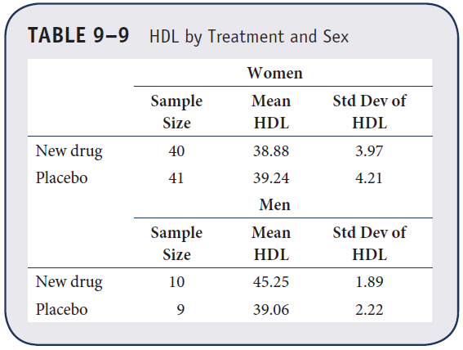
Example 9.2. Effect Modification (2 of 2)
Is there effect modification by gender?

Slide 10
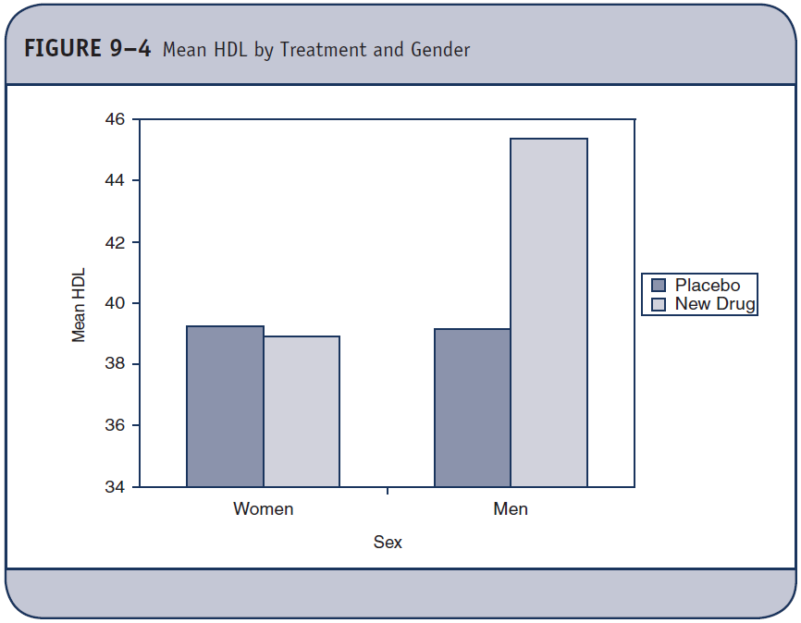
Effect Modification

Slide 11
Cochran-Mantel-Haenszel Method
Technique to estimate association between risk factor and outcome accounting for confounding
Data are organized into stratum and associations are estimated in each stratum and combined.

Slide 12
Correlation and Simple Linear Regression Analysis
Two continuous variables
Y = dependent, outcome variable
X = independent, predictor variable
Relationship between age and SBP, number of hours of exercise and percent body fat, caffeine consumption and blood sugar level.

Slide 13
Correlation and Simple Linear Regression
Correlation—nature and strength of linear association between variables
Regression—equation that best describes relationship between variables

Slide 14
Scatter Diagram

Slide 15
Correlation Coefficient
Population correlation ρ
Sample correlation r, –1 ≤ r ≤ +1
Sign indicates nature of relationship (positive or direct, negative, or inverse).
Magnitude indicates strength.

Slide 16
Direct Relationship Between X and Y, r = 0.6

Slide 17
Inverse Relationship Between X and Y, r = –0.6

Slide 18
Sample Correlation Coefficient

Slide 19
Example (1 of 6)
Suppose we are interested in the relationship between body mass index (BMI; computed as the ratio of weight in kilograms to height in meters squared) and systolic blood pressure in males 50 years of age.

Slide 20
Example (2 of 6)
A random sample of 10 males 50 years of age is selected and their weights, heights, and systolic blood pressures are measured.
Their weights and heights are transformed into body mass index scores (see next slide).
In this analysis, the independent (or predictor) variable is BMI and the dependent (or response) variable is systolic blood pressure.

Slide 21
Example (3 of 6)
Data
X = BMI Y = SBP
18.4 120
20.1 110
22.4 120
25.9 135
26.5 140
28.9 115
30.1 150
32.9 165
33.0 160
34.7 180

Slide 22
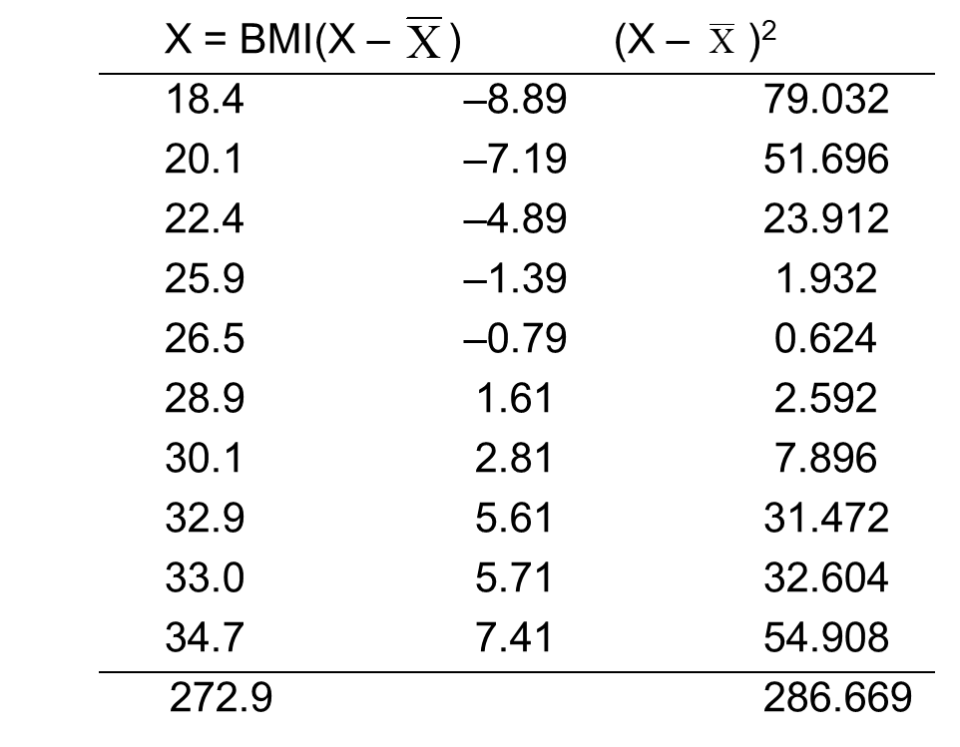
Example (4 of 6)
= 27.29

Slide 23
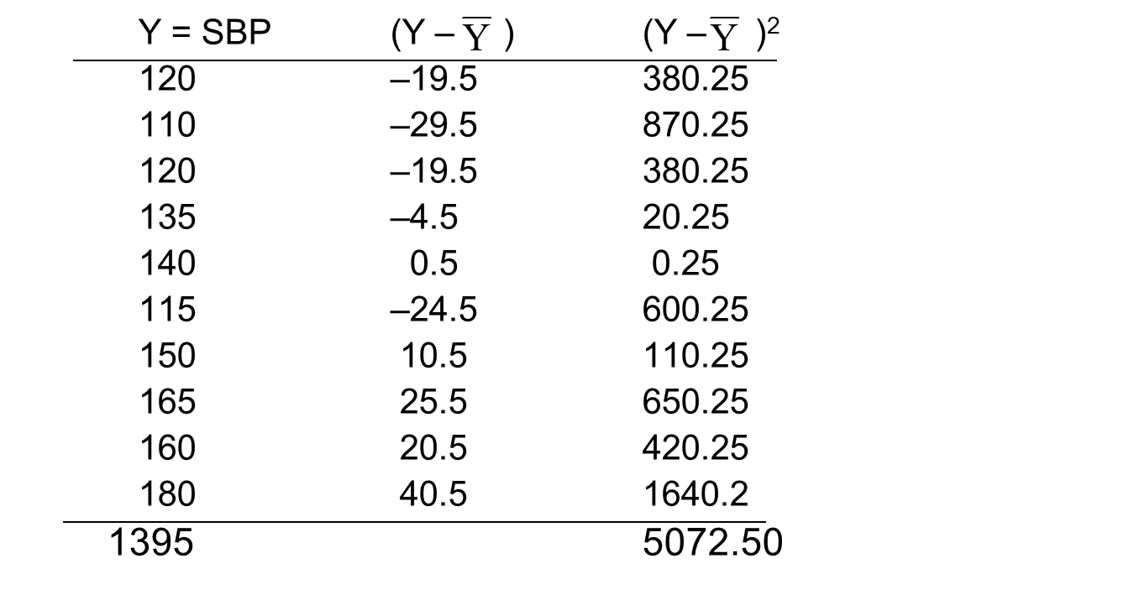
Example (5 of 6)
= 139.5

Slide 24
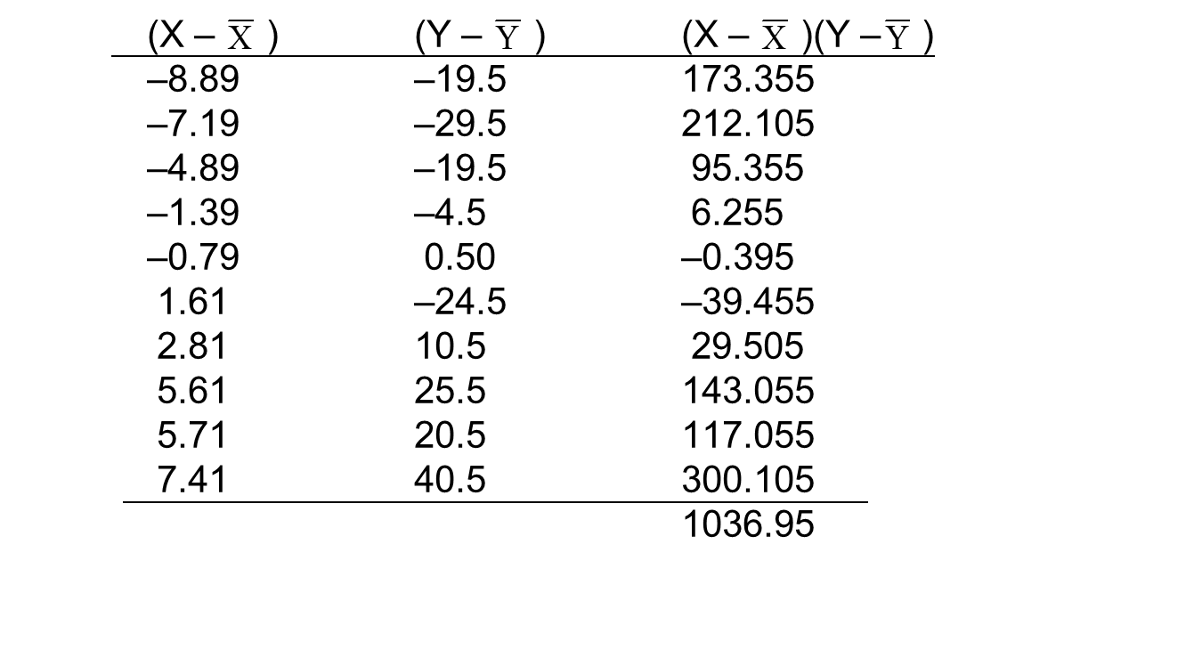
Example (6 of 6)
cov (X,Y) = 1036.95/9
= 115.22

Slide 25
Sample Correlation Coefficient

Slide 26
Example (1 of 2)
Suppose in the same study we also measure the number of hours of vigorous exercise per week.
Is there a relationship between the number of hours of exercise and SBP in males 50 years of age?

Slide 27
Example (2 of 2)
Data
X = Hours of Exercise Y = SBP
4 120
10 110
2 120
3 135
3 140
5 115
1 115
2 165
2 160
0 180

Slide 28
Sample Correlation Coefficient

Slide 29
Simple Linear Regression
Y = Dependent, outcome variable
X = Independent, predictor variable
= b₀ + b₁ x
b₀ is the Y-intercept, b₁ is the slope

Slide 30
Simple Linear Regression Assumptions
Linear relationship between X and Y
Independence of errors
Homoscedasticity (constant variance) of the errors
Normality of errors

Slide 31
Least Squares Estimates of Regression Parameters

Slide 32
Regression Analysis: BMI and SBP

Slide 33
Using Regression Equation
What is expected SBP for a male with BMI = 20?
Compare two males whose BMIs differ by 2 units. How do SBPs compare?
Person with higher BMI will have SBP that is 2(3.61) = 7.22 units higher.

Slide 34
Regression Analysis: Exercise and SBP

Slide 35
Example 9.6. Linear Regression Analysis
Clinical trial to assess the efficacy of a new drug to increase HDL cholesterol
where 1 = new drug and 0 = placebo

Slide 36
Multiple Linear Regression
Y = continuous outcome variable
X₁, X₂, …, X_{p} = set of independent or predictor variables

Slide 37
Multiple Regression Analysis (1 of 2)
Model is conditional, parameter estimates are conditioned on other variables in model.
Perform overall test of regression.
If significant, examine individual predictors.
Relative importance of predictors by p-values (or standardized coefficients)

Slide 38
Multiple Regression Analysis (2 of 2)
Predictors can be continuous, indicator variables (0/1), or a set of dummy variables.
Dummy variables (for categorical predictors)
Race: white, black, Hispanic
Black (1 if black, 0 otherwise)
Hispanic (1 if Hispanic, 0 otherwise)

Slide 39
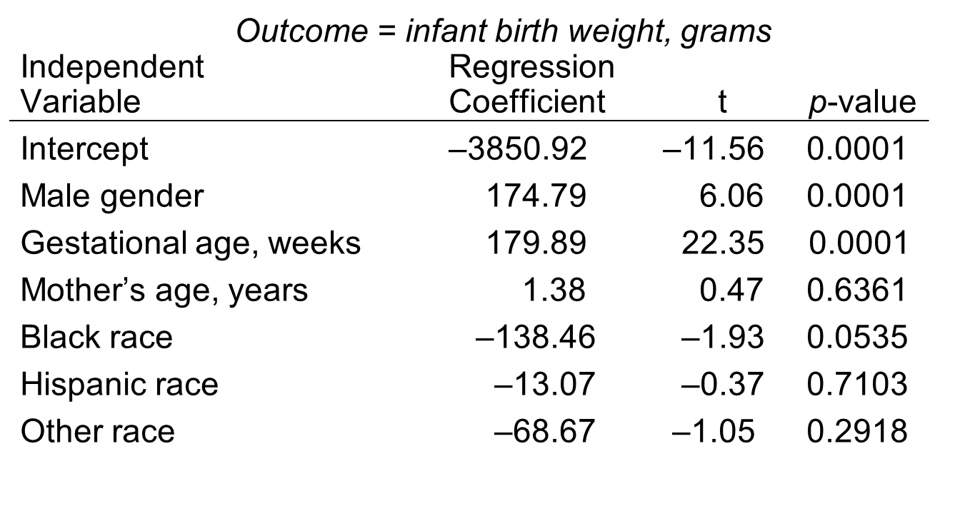
Example 9.7. Multiple Linear Regression Analysis

Slide 40
Simple Logistic Regression Analysis
Outcome is dichotomous (1 = event, 0 = non-event) and p = P(event).
Outcome is modeled as log odds.

Slide 41
Multiple Logistic Regression Analysis
Outcome is dichotomous (1 = event, 0 = non-event) and p = P(event).
Outcome is modeled as log odds.

Slide 42
Example 9.8. Logistic Regression Analysis
Study to assess the relationship between obesity and incident CVD

Slide 43
Estimation of Regression Coefficients
Model parameters are estimated using maximum likelihood techniques.
b₁ is the log odds ratio.
exp(b₁) is the odds ratio estimate from a logistic regression model.

Slide 44
Interpretation of Regression Coefficients in Logistic Regression (1 of 2)
With a dichotomous predictor X, b₁ is a log odds ratio for success for group1 versus group2.
With a continuous predictor X, b₁ is a log odds ratio for success per unit change in X.

Slide 45
Interpretation of Regression Coefficients in Logistic Regression (2 of 2)
b₁ = 0 ⇒ No association between Y and X
b₁ > 0 ⇒ Probability of success increases as X increases
b₁ < 0 ⇒ Probability of success decreases as X increases

Slide 46
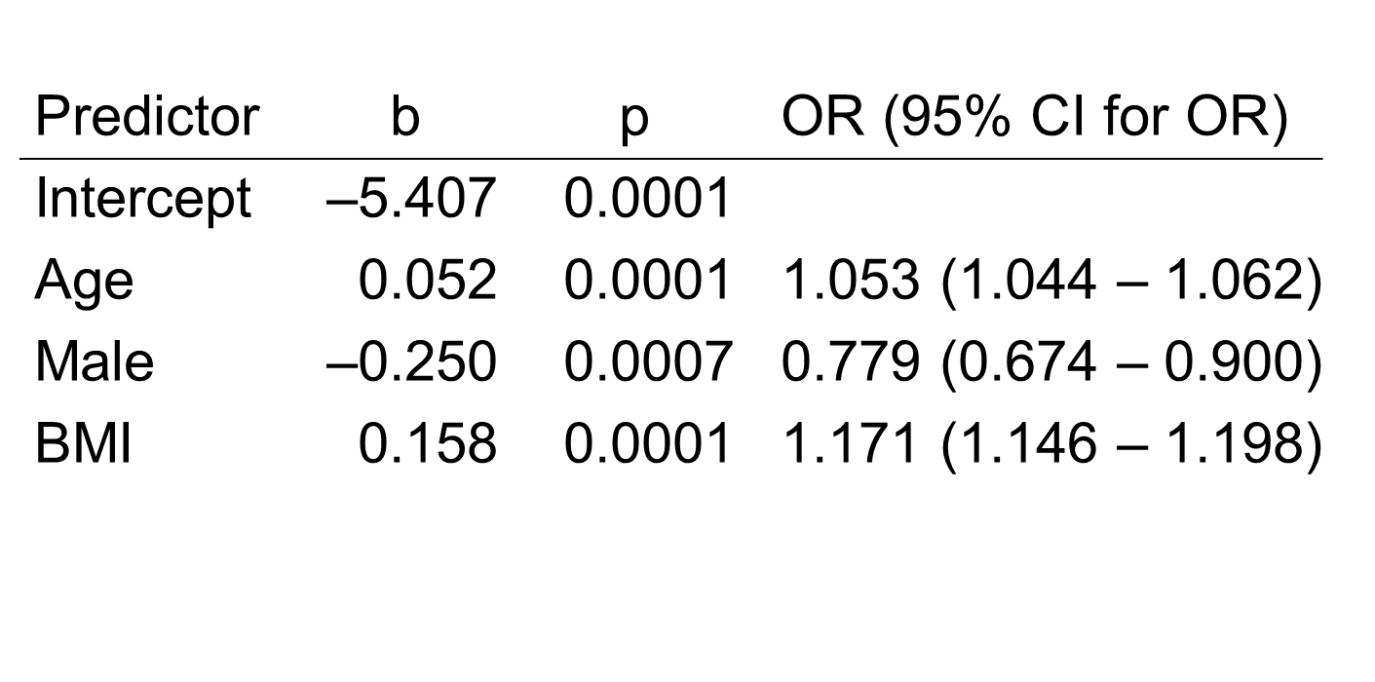
Multiple Logistic Regression Model for Hypertension (Y/N)

